Slide 1
1.1 Introduction to Language Processor
A language processor is a software which bridges a specification and execution gap.
Language processing activities arise due to:
  The difference between software designer’s idea related to behavior of software and the manner in which these ideas are implemented.

Slide 2
Introduction to Language Processor
The designer expresses the ideas in terms related to the application domain.
To implement these ideas in terms related to execution domain.
The difference between the two domain termed as semantic gap.
Semantic Gap
Application Execution
Domain Domain

Slide 3
Introduction to Language Processor
The semantic gap has many difficulties, some of the important ones being large development time and efforts, and poor quality of software.
These issues are tackled through the use of programming language (PL).
Software implementation using PL introduces a new domain as PL domain.

Slide 4
Introduction to Language Processor
Now the semantic gap is bridged by the software engineering steps.
The first step bridges gap between application domain and PL domain known as specification gap.
While the second step bridges the gap between PL domain and execution domain as execution gap.
Specification Gap Execution Gap
Application PL Execution
Domain Domain Domain

Slide 5
Introduction to Language Processor
The specification gap is bridge by the software development team.
While the execution gap is bridged by the designer of the programming language processor. Like compiler or interpreter.
PL domain reduces the difficulties of semantic gap mentioned earlier.
The language processor also provides a diagnostics capability which detects and indicates errors in its input. This helps in improving the quality of the software.

Slide 6
Introduction to Language Processor
Language processor is a software which bridges a specification or execution gap.
We use term language processing to describe the activity performed by a language processor.
We refer to the program form input to a language processor as source program and its output as the target program.
The language in which these programs are written are called source language and target language.

Slide 7
Introduction to Language Processor
A range of LP is defined to meet practical requirements.
A language translator bridges an execution gap to the machine language like assembler and compiler.
A detranslator bridges the same as the language translator, but in the reverse manner.
A preprocessor is a language processor which bridges an execution gap but not translator.
A language migrator bridges specification gap between two PLs.

Slide 8
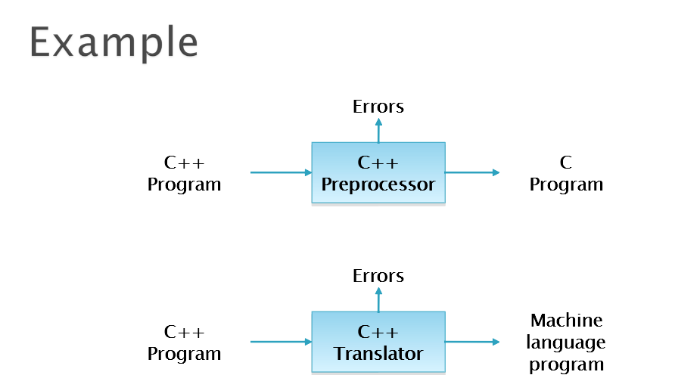

Slide 9
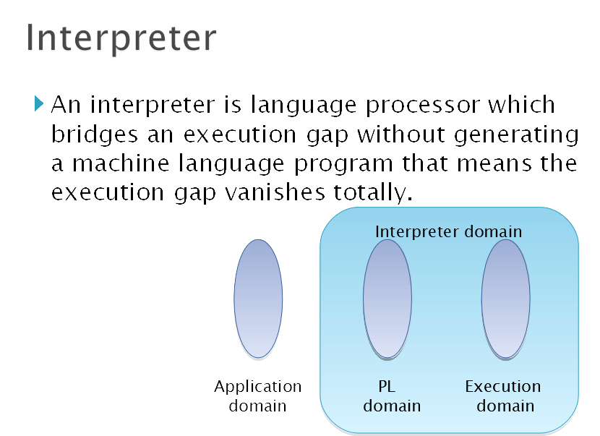

Slide 10
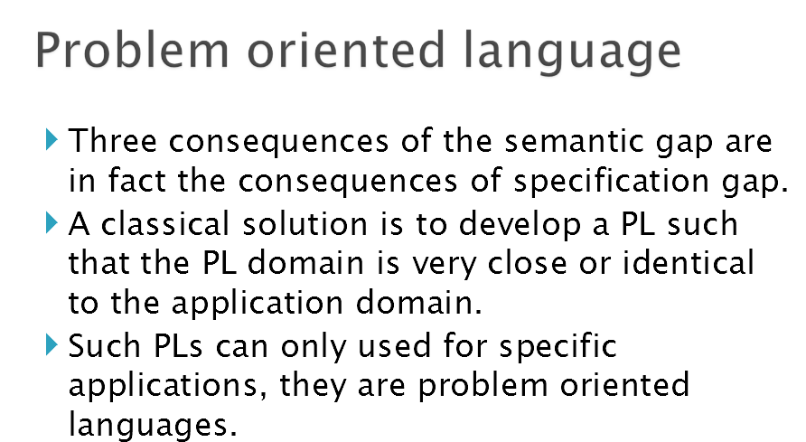

Slide 11
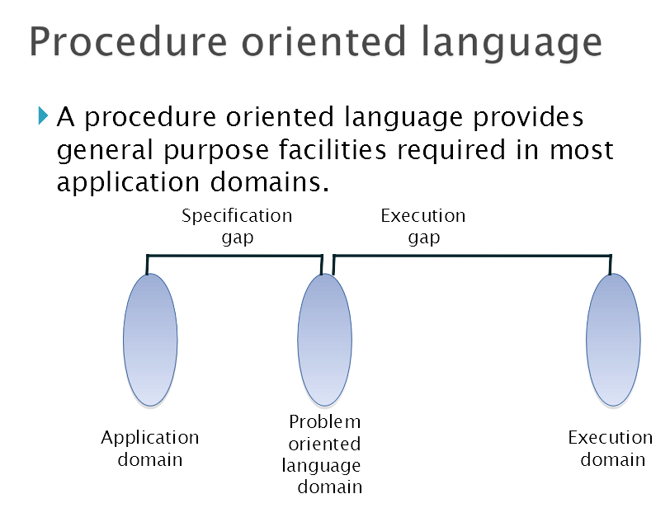

Slide 12
Language Processing
Fundamental activities divided into those that bridge the specification gap and execution gap.
  Program generation activities
  Program execution activities

Slide 13
Cont..
Program generation activities
  A program generation activity aims at automatic generation of a program.
  A source language is a specification language of an application domain and the target language is procedure oriented PL.
  Program generator introduces a new domain between the application and PL domain , call this the program generator domain.
  Specification gap now between Application domain and program generation domain, reduction in the specification gap increases the reliability of the generated program.

Slide 14
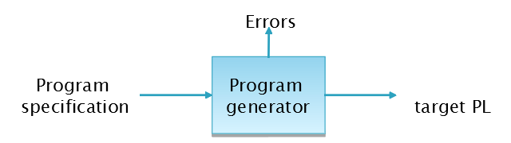
Cont..
This arrangement also reduces the testing effort.

Slide 15
Cont..
Program Execution
  Two popular model
    Program Translation
    Program Interpretation

Slide 16
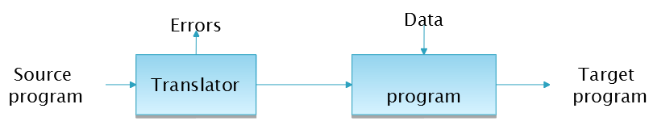
The program translation model bridges the execution gap by translating a sources program into program in the machine or assembly language of the computer system, called target program.

Slide 17
Cont..
Characteristics of the program translation model:
A program must be translated before it can be executed
The translated program may be saved in a file. The saved program may be executed repeatedly.
A program must be retranslated following modifications.

Slide 18
Cont..
Program interpretation: during interpretation interpreter takes source program statement, determines its meaning and performs actions which implement it.
The function of an interpreter is same as the execution of machine language program by CPU.

Slide 19
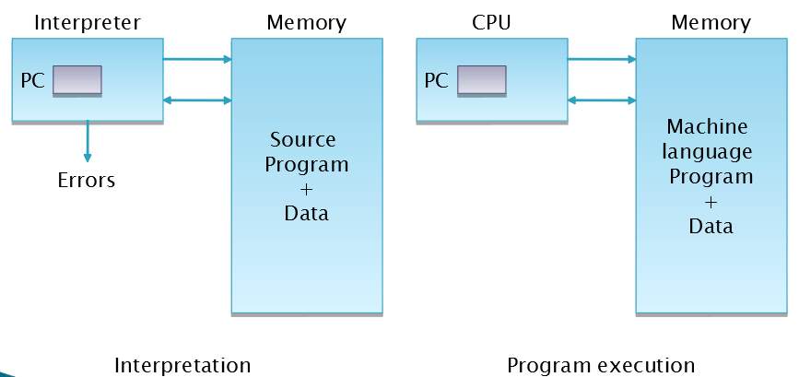
Cont..

Slide 20
MCQ
The designer expresses the ideas in terms related to the __________ of the software.
A. Application Domain
B. Execution Domain
C. PL Domain
D. Program Generator Domain

Slide 21
MCQ
The designer expresses the ideas in terms related to the __________ of the software.
A. Application Domain
B. Execution Domain
C. PL Domain
D. Program Generator Domain

Slide 22
MCQ
The gap between Application domain and PL domain is called__________.
A. Execution Gap
B. Specification Gap
C. Application Gap
D. Semantic Gap

Slide 23
MCQ
The gap between Application domain and PL domain is called__________.
A. Execution Gap
B. Specification Gap
C. Application Gap
D. Semantic Gap

Slide 24
MCQ
A __________ is software which bridges a specification or execution gap.
A. Language Processor
B. Editor
C. Application
D. None

Slide 25
MCQ
A __________ is software which bridges a specification or execution gap.
A. Language Processor
B. Editor
C. Application
D. None

Slide 26
MCQ
The gap between PL domain and Execution domain is called__________.
A. Semantic Gap
B. Specification Gap
C. Application Gap
D. Execution Gap

Slide 27
MCQ
The gap between PL domain and Execution domain is called__________.
A. Semantic Gap
B. Specification Gap
C. Application Gap
D. Execution Gap

Slide 28
Short Questions
Draw a diagram of a language processing system.
What is meaning of Language Processing?
Define : Application Domain & Execution Domain
Define: Specification Gap & Execution Gap

Slide 29
Long Questions
What is Language Processing? Explain Application, PL & Execution domain.
What is Language Processing? Explain spectrum of language processor.
Explain Language Processing Activity in detail.

